Slide 1
Resident Evil: The Final Chapter (2016)
MAC 425 / 5739
Inteligência Artificial
aprendizado por reforço aproximado

Slide 2
contexto
✔︎ Parte I - Busca em espaço de estados
✔︎ Parte 2 – Raciocínio Lógico
✔︎ Parte 3 - Raciocínio Probabilístico e Tomada de decisão sob incerteza
Parte 4 - Aprendizado de máquina
Aprendizado por reforço
Aprendizado supervisionado
Aprendizado profundo

Slide 3
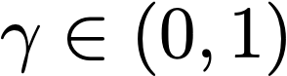
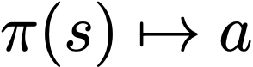
s
markov decision process
a
s,a
Sequential decision making (t=1,2,…)
States S, Actions A
Transition model: T(s,a,s’) = Pr(s’|s,a)
Immediate Reward R(s,a) discounted by
Fully observable, stationary environment
agent behavior depends on current state:
s,a,s’
T(s,a,s’), R(s,a)
s’

Slide 4
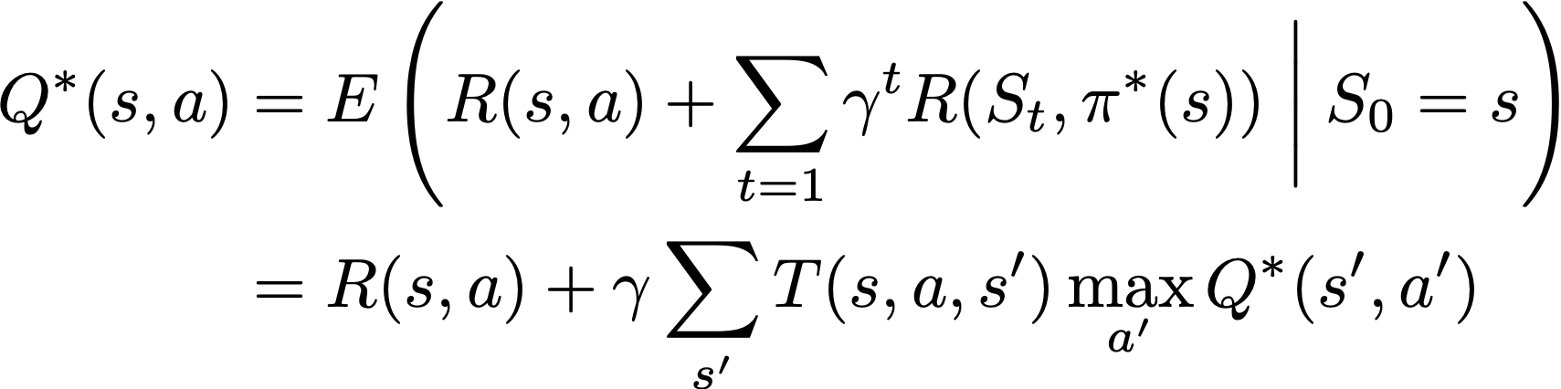
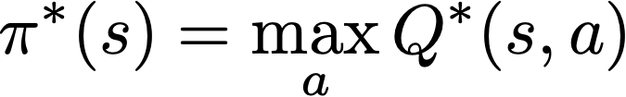
markov decision process
Optimal Q-Value: Expected utility of taking action a in s, then acting optimally
Optimal policy is greedy w.r.t. Q*:
Notes:
Q^*(s,a) &= E\left( R(s,a) + \sum_{t=1} \gamma^t R(S_t,\pi^*(s)) \biggm\vert S_0 = s \right) \\
& = R(s,a) + \gamma \sum_{s'} T(s,a,s’) \max_{a'} Q^*(s’,a')

Slide 5
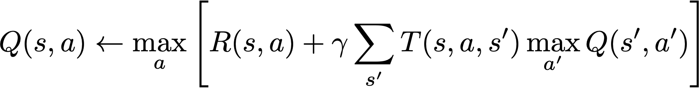
Value Iteration
Solves fully specified MDP
Repeat until convergence:
Quadratic time complexity in |S|, linear in error, exponential in discount factor
Notes:
Q(s,a) \gets \max_a \left[ R(s,a) + \gamma \sum_{s'} T(s,a,s’)\max_{a’} Q(s',a') \right]

Slide 6
reinforcement learning
Learn Markov Decision Process agent for unknown environment
Current state is known (full observability)
Applicable actions in current state are known
State transition functions are unknown
Rewards are observed upon acting
Data collection depends on agent’s policy (exploration)
Agent’s policy depends on gathered data (exploitation)

Slide 7
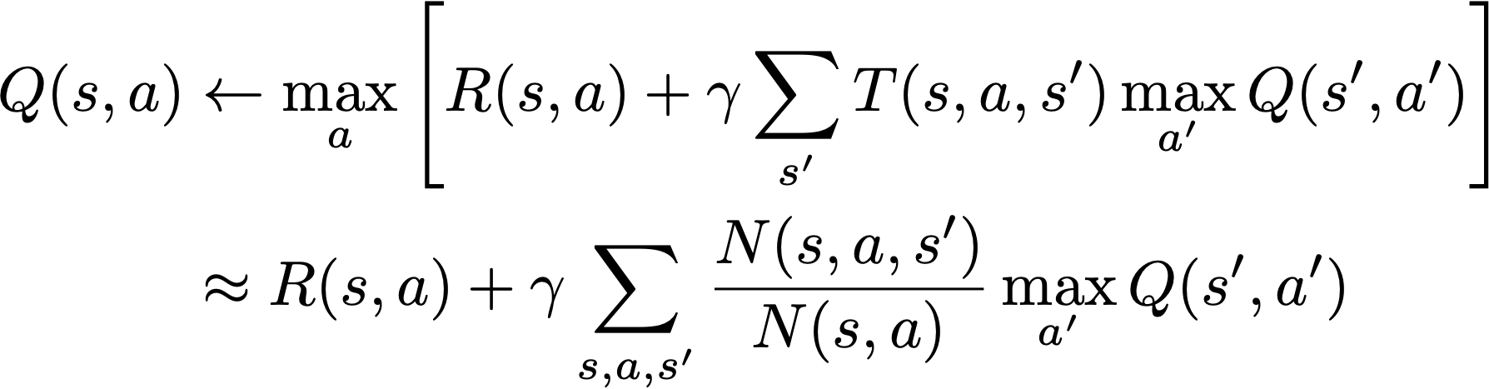


Q-Learning
Intuition: Replace expectation with average of samples
Adapt more quickly by computing running average
counts of observed transitions s,a,s’
learning rate
Notes:
Q(s,a) &\gets \max_a \left[ R(s,a) + \gamma \sum_{s'} T(s,a,s’)\max_{a'} Q(s',a') \right]\\
& \approx R(s,a) + \gamma \sum_{s,a,s'} \frac{N(s,a,s')}{N(s,a)} \max_{a'} Q(s',a')
Q(s,a) \gets (1-\alpha)Q(s,a) + \alpha \left[ R(s,a) + \gamma \max_{a'} Q(s',a') \right]

Slide 8
Q-learning Algorithm
Estimates the Q* function by interacting with environment
Initialize Q arbitrarily (usually Q=0)
Observe the current state s
repeat
select an action a and execute it in s
receive immediate reward R(s,a)
observe the new state s’
update Q(s,a) as follows:
Q(s,a) ← (1−α)Q(s,a) + α[R(s,a) + γ max_{a’} Q(s’,a’)]
s ← s’
Οφφ−πολιχψ: λεαρνσ οπτιμαλ πολιχψ υσινγ συβοπτιμαλ πολιχψ

Slide 9
exercise
Agent takes action go up in s_{1,} receives reward 0 and transits to s₂
Discount factor: γ = 0.9
Q =
Learning rate: α=1
Q(s1,up) = ?
s₂
73
100
10
s₁
66
70
81

Slide 10
exercise
Agent takes action go up in s_{1,} receives reward 0 and transits to s₂
Discount factor: γ = 0.9
Q =
Learning rate: α=1
s₂
73
100
10
s₁
66
70
81
Q(s₁, up)
= R(s1,up) + γ max_{a’} Q(s₂, a’)
= 0 + 0.9 max {73, 70, 100}
= 90

Slide 11
flappy bird RL
Actions: click, do nothing
Rewards: +1 if alive, -1000 if dead
State space:
vertical distance from lower pipe
horizontal distance to following pipes
is alive?
https://www.youtube.com/watch?v=xM62SpKAZHU
https://sarvagyavaish.github.io/FlappyBirdRL/

Slide 12


Slide 13
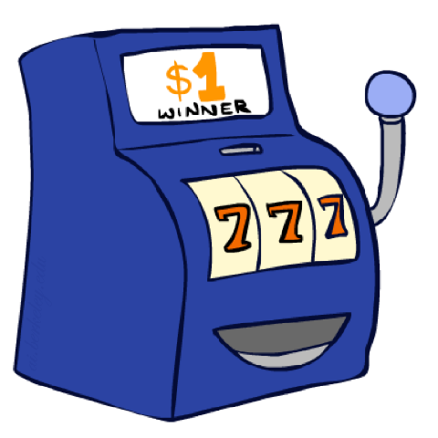
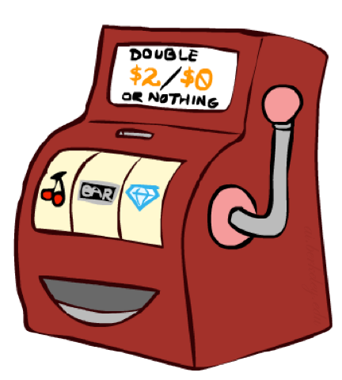
issues with q-learning
Exploration versus Exploitation dilemma
Exploration guarantees that every state is visited sufficiently often (so as to guarantee convergence)
Exploitation guarantees fast(er) convergence to optimal policy in the subspace that we care about
Learning rate
Large values makes learning unstable
Small values lead to slow convergence
Solution: Use function of number of times state has been visited — larger values on rarely visited states, small values in often visited states

Slide 14
k-Armed Bandit
Every time you pull an arm on a machine, it either pays off $2 or nothing
Each machine has a (different) hidden probability of paying off
Whenever you pull an arm, the outcome is independent of previous outcomes and is determined by the hidden payoff probability
…
k machines

Slide 15
k-Armed Bandit: Policies
Behave at random
guarantees convergence, but obtains low pay off
Always choose the apparent best: keep estimates of the expected payoff of each arm; choose arm with highest expected pay off
greedy strategy, may not converge
Combined: e.g. choose the apparent best 90% of the time; choose randomly the other 10%
guarantees convergence while achieving high pay off

Slide 16
GRIDWORLD MDP
 |  | S
 |  | G
Reward
R( ) = -1
R( ) = -10
R( ) = -0.25
R( ) = 0
Deterministic actions
Moving out of grid leaves agent in same state/cell
No discount factor
G is absorbing state

Slide 17
optimal policy
greedy policy
random policy
V* 32 iterations
-13 | -12 | -11 | -10 | -9 | -8 | -7 | -6
-13 | -13 | -12 | -11 | -10 | -9 | -15.8 | -5.8
-12 | -12 | -11 | -12 | -11 | -10 | -15.5 | -5.5
-11 | -11 | -10 | -11 | -12 | -13 | -14 | -5.2
-10 | -10 | 0 | -1 | -2 | -3 | -4 | -5
-9 | -8 | -10 | -11 | -3 | -4 | -14 | -6
-8 | -7 | -6 | -5 | -4 | -5 | -6 | -7
-9 | -8 | -7 | -6 | -5 | -6 | -7 | -6
Q 1000 episodes ~4k interactions
-10 | -9.9 | -9.7 | -9.7 | -9 | -8 | -7 | -6
-10 | -10.3 | -10.3 | -10.1 | -9.2 | -8.9 | -10.1 | -5.7
-10.1 | -10.1 | -11 | -10.4 | -9.5 | -9.1 | -10.7 | -5.5
-9.3 | -9.7 | -10 | -9.9 | -9.9 | -10.7 | -10.1 | -5.2
-9.1 | -9.9 | 0 | -1 | -2 | -3 | -4 | -5
-8.2 | -7.8 | -9 | -9.8 | -3 | -3.6 | -9.9 | -4.8
-7.6 | -7 | -6 | -5 | -4 | -4.4 | -4.5 | -4.3
-7.4 | -6.5 | -6.2 | -5.5 | -4.8 | -4.6 | -4.5 | -4.7
Q 1000 episodes ~90k interactions
-13 | -12 | -11 | -10 | -9 | -8 | -7 | -6
-13 | -13 | -12 | -11 | -10 | -9 | -15.8 | -5.8
-12 | -12 | -11 | -12 | -11 | -10 | -15.5 | -5.5
-11 | -11 | -10 | -11 | -12 | -13 | -14 | -5.2
-10 | -10 | 0 | -1 | -2 | -3 | -4 | -5
-9 | -8 | -10 | -11 | -3 | -4 | -14 | -6
-8 | -7 | -6 | -5 | -4 | -5 | -6 | -7
-9 | -8 | -7 | -6 | -5 | -6 | -7 | -8
N(S)
44 | 45 | 44 | 46 | 46 | 46 | 42 | 86
44 | 49 | 51 | 49 | 45 | 34 | 8 | 82
45 | 54 | 1031 | 42 | 35 | 25 | 9 | 79
45 | 29 | 974 | 9 | 9 | 8 | 8 | 63
36 | 8 | 0 | 33 | 37 | 29 | 28 | 41
40 | 22 | 6 | 7 | 22 | 15 | 8 | 19
35 | 35 | 28 | 26 | 26 | 21 | 17 | 19
31 | 31 | 29 | 25 | 21 | 21 | 20 | 18
2237 | 2215 | 2235 | 2094 | 2046 | 1798 | 1764 | 1782
2235 | 2310 | 2493 | 2130 | 1891 | 1765 | 1652 | 1615
1922 | 2223 | 3089 | 2110 | 1755 | 1594 | 1522 | 1430
1415 | 1469 | 1560 | 1450 | 1436 | 1381 | 1421 | 1364
1041 | 847 | 0 | 828 | 1159 | 1313 | 1288 | 1249
851 | 772 | 611 | 818 | 1049 | 1219 | 1235 | 1262
757 | 717 | 731 | 852 | 1014 | 1086 | 1090 | 1117
727 | 699 | 787 | 890 | 999 | 1077 | 1051 | 1060
learning rate = 0.9
Notes:
run with RL.jl with 1000 episodes (MDP.jl with 32 iterations)

Slide 18
LEARNING policies
The best strategies (in the long run) spend
some time exploring: e.g. trying all the arms to see what their probabilities are like
some time exploiting: w.g. doing the apparently best action to try to get maximum reward
ε-greedy policy
with probability ε, act randomly
with probability 1-ε, act greedily
(possibly the greedy action)

Slide 19
greedy policy
0.1-greedy policy (explore 10% of time)
random policy
Q 1000 episodes ~4k interactions
-10 | -9.9 | -9.7 | -9.7 | -9 | -8 | -7 | -6
-10 | -10.3 | -10.3 | -10.1 | -9.2 | -8.9 | -10.1 | -5.7
-10.1 | -10.1 | -11 | -10.4 | -9.5 | -9.1 | -10.7 | -5.5
-9.3 | -9.7 | -10 | -9.9 | -9.9 | -10.7 | -10.1 | -5.2
-9.1 | -9.9 | 0 | -1 | -2 | -3 | -4 | -5
-8.2 | -7.8 | -9 | -9.8 | -3 | -3.6 | -9.9 | -4.8
-7.6 | -7 | -6 | -5 | -4 | -4.4 | -4.5 | -4.3
-7.4 | -6.5 | -6.2 | -5.5 | -4.8 | -4.6 | -4.5 | -4.7
Q 1000 episodes ~5k interactions
-11.5 | -11.2 | -11 | -10 | -9 | -8 | -7 | -6
-11.8 | -11.7 | -12 | -11 | -10 | -9 | -15.7 | -5.8
-11.5 | -12 | -11 | -12 | -11 | -10 | -10.7 | -5.5
-10.7 | -11 | -10 | -11 | -11.9 | -12.7 | -14 | -5.2
-9.9 | -10 | 0 | -1 | -2 | -3 | -4 | -5
-9 | -8 | -9.9 | -11 | -3 | -4 | -10.9 | -5.9
-8 | -7 | -6 | -5 | -4 | -4.8 | -4.8 | -5.3
-7.7 | -7 | -6.4 | -5.6 | -4.7 | -5.1 | -4.7 | -4.5
Q 1000 episodes ~90k interactions
-13 | -12 | -11 | -10 | -9 | -8 | -7 | -6
-13 | -13 | -12 | -11 | -10 | -9 | -15.8 | -5.8
-12 | -12 | -11 | -12 | -11 | -10 | -15.5 | -5.5
-11 | -11 | -10 | -11 | -12 | -13 | -14 | -5.2
-10 | -10 | 0 | -1 | -2 | -3 | -4 | -5
-9 | -8 | -10 | -11 | -3 | -4 | -14 | -6
-8 | -7 | -6 | -5 | -4 | -5 | -6 | -7
-9 | -8 | -7 | -6 | -5 | -6 | -7 | -8
N(S)
49 | 51 | 58 | 63 | 74 | 83 | 77 | 124
52 | 57 | 87 | 71 | 62 | 49 | 14 | 116
57 | 78 | 1066 | 62 | 48 | 34 | 11 | 121
56 | 64 | 961 | 49 | 14 | 12 | 15 | 103
46 | 26 | 0 | 113 | 84 | 67 | 66 | 77
50 | 26 | 7 | 11 | 33 | 22 | 11 | 24
43 | 43 | 35 | 31 | 32 | 25 | 22 | 25
34 | 32 | 29 | 25 | 24 | 25 | 21 | 19
2237 | 2215 | 2235 | 2094 | 2046 | 1798 | 1764 | 1782
2235 | 2310 | 2493 | 2130 | 1891 | 1765 | 1652 | 1615
1922 | 2223 | 3089 | 2110 | 1755 | 1594 | 1522 | 1430
1415 | 1469 | 1560 | 1450 | 1436 | 1381 | 1421 | 1364
1041 | 847 | 0 | 828 | 1159 | 1313 | 1288 | 1249
851 | 772 | 611 | 818 | 1049 | 1219 | 1235 | 1262
757 | 717 | 731 | 852 | 1014 | 1086 | 1090 | 1117
727 | 699 | 787 | 890 | 999 | 1077 | 1051 | 1060
learning rate = 0.9
Notes:
run with RL.jl with 1000 episodes (MDP.jl with 32 iterations)

Slide 20
learning policies
ε-greedy policy continues to act sub-optimally (and even dangerously) once learning is done
Fix: lower ε with time
Better fix: use exploration function
Tentative exploration behaviour
keep state-visits count and explore states with low count
explore areas whose quality has not yet been established

Slide 21
Optimistic exploration function
Takes value q and count n and returns optimistic q-value
e.g., f(q,n) = q + k/n for some given k > 0
Modified Q-Learning
Notes:
\color{red}Q(s,a) \gets (1-\alpha)Q(s,a) + \alpha \left[ R(s,a) + \gamma \max_{a'} f\Bigl( Q(s',a'), N(s',a') \Bigr) \right]

Slide 22
optimal policy
greedy policy
random policy
V* 32 iterations
-13 | -12 | -11 | -10 | -9 | -8 | -7 | -6
-13 | -13 | -12 | -11 | -10 | -9 | -15.8 | -5.8
-12 | -12 | -11 | -12 | -11 | -10 | -15.5 | -5.5
-11 | -11 | -10 | -11 | -12 | -13 | -14 | -5.2
-10 | -10 | 0 | -1 | -2 | -3 | -4 | -5
-9 | -8 | -10 | -11 | -3 | -4 | -14 | -6
-8 | -7 | -6 | -5 | -4 | -5 | -6 | -7
-9 | -8 | -7 | -6 | -5 | -6 | -7 | -6
Q 1000 episodes ~4k interactions
-10 | -9.9 | -9.7 | -9.7 | -9 | -8 | -7 | -6
-10 | -10.3 | -10.3 | -10.1 | -9.2 | -8.9 | -10.1 | -5.7
-10.1 | -10.1 | -11 | -10.4 | -9.5 | -9.1 | -10.7 | -5.5
-9.3 | -9.7 | -10 | -9.9 | -9.9 | -10.7 | -10.1 | -5.2
-9.1 | -9.9 | 0 | -1 | -2 | -3 | -4 | -5
-8.2 | -7.8 | -9 | -9.8 | -3 | -3.6 | -9.9 | -4.8
-7.6 | -7 | -6 | -5 | -4 | -4.4 | -4.5 | -4.3
-7.4 | -6.5 | -6.2 | -5.5 | -4.8 | -4.6 | -4.5 | -4.7
Q 1000 episodes ~90k interactions
-13 | -12 | -11 | -10 | -9 | -8 | -7 | -6
-13 | -13 | -12 | -11 | -10 | -9 | -15.8 | -5.8
-12 | -12 | -11 | -12 | -11 | -10 | -15.5 | -5.5
-11 | -11 | -10 | -11 | -12 | -13 | -14 | -5.2
-10 | -10 | 0 | -1 | -2 | -3 | -4 | -5
-9 | -8 | -10 | -11 | -3 | -4 | -14 | -6
-8 | -7 | -6 | -5 | -4 | -5 | -6 | -7
-9 | -8 | -7 | -6 | -5 | -6 | -7 | -8
N(S)
44 | 45 | 44 | 46 | 46 | 46 | 42 | 86
44 | 49 | 51 | 49 | 45 | 34 | 8 | 82
45 | 54 | 1031 | 42 | 35 | 25 | 9 | 79
45 | 29 | 974 | 9 | 9 | 8 | 8 | 63
36 | 8 | 0 | 33 | 37 | 29 | 28 | 41
40 | 22 | 6 | 7 | 22 | 15 | 8 | 19
35 | 35 | 28 | 26 | 26 | 21 | 17 | 19
31 | 31 | 29 | 25 | 21 | 21 | 20 | 18
2237 | 2215 | 2235 | 2094 | 2046 | 1798 | 1764 | 1782
2235 | 2310 | 2493 | 2130 | 1891 | 1765 | 1652 | 1615
1922 | 2223 | 3089 | 2110 | 1755 | 1594 | 1522 | 1430
1415 | 1469 | 1560 | 1450 | 1436 | 1381 | 1421 | 1364
1041 | 847 | 0 | 828 | 1159 | 1313 | 1288 | 1249
851 | 772 | 611 | 818 | 1049 | 1219 | 1235 | 1262
757 | 717 | 731 | 852 | 1014 | 1086 | 1090 | 1117
727 | 699 | 787 | 890 | 999 | 1077 | 1051 | 1060
Initialize Q = 0
Then f=q is optimistic
Why?
Notes:
run with RL.jl with 1000 episodes (MDP.jl with 32 iterations)

Slide 23
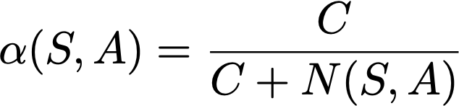
learning rate
Make it dependent on state-action pair
Start aggressive, and decrease learning rate every new visit to state
e.g.,

Slide 24
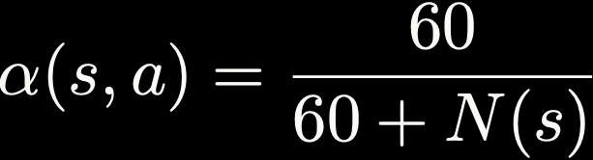
optimal policy
greedy policy (initializing with Q=0)
random policy
V* 32 iterations
-13 | -12 | -11 | -10 | -9 | -8 | -7 | -6
-13 | -13 | -12 | -11 | -10 | -9 | -15.8 | -5.8
-12 | -12 | -11 | -12 | -11 | -10 | -15.5 | -5.5
-11 | -11 | -10 | -11 | -12 | -13 | -14 | -5.2
-10 | -10 | 0 | -1 | -2 | -3 | -4 | -5
-9 | -8 | -10 | -11 | -3 | -4 | -14 | -6
-8 | -7 | -6 | -5 | -4 | -5 | -6 | -7
-9 | -8 | -7 | -6 | -5 | -6 | -7 | -6
Q 1000 episodes ~4.5k interactions
-10.3 | -10.2 | -10.3 | -9.7 | -8.9 | -7.9 | -7 | -6
-10.3 | -10.3 | -10.5 | -10 | -9.4 | -8.8 | -10.2 | -5.7
-10 | -10.3 | -11 | -10.4 | -9.9 | -9.5 | -10.2 | -5.5
-9.4 | -10 | -10 | -11 | -11.6 | -10.8 | -10.2 | -5.2
-8.6 | -10 | 0 | -1 | -2 | -3 | -4 | -5
-7.9 | -7.8 | -10 | -10.8 | -3 | -3.6 | -10.8 | -4.9
-7.6 | -7 | -6 | -5 | -4 | -4.3 | -4.5 | -4.6
-7.4 | -7 | -6.3 | -5.7 | -5 | -4.7 | -4.4 | -4.4
Q 1000 episodes ~93k interactions
-13 | -12 | -11 | -10 | -9 | -8 | -7 | -6
-13 | -13 | -12 | -11 | -10 | -9 | -15.7 | -5.7
-12 | -12 | -11 | -12 | -11 | -10 | -15.5 | -5.5
-11 | -11 | -10 | -11 | -12 | -13 | -14 | -5.2
-10 | -10 | 0 | -1 | -2 | -3 | -4 | -5
-9 | -8 | -10 | -11 | -3 | -4 | -14 | -6
-8 | -7 | -6 | -5 | -4 | -5 | -6 | -7
-9 | -8 | -7 | -6 | -5 | -6 | -7 | -8
N(S)
52 | 57 | 59 | 56 | 54 | 56 | 53 | 143
56 | 61 | 69 | 62 | 55 | 41 | 8 | 131
60 | 68 | 1040 | 54 | 44 | 29 | 8 | 122
58 | 34 | 961 | 10 | 9 | 8 | 8 | 89
42 | 8 | 0 | 44 | 46 | 36 | 34 | 47
46 | 27 | 7 | 8 | 25 | 16 | 8 | 19
42 | 42 | 30 | 28 | 31 | 22 | 19 | 22
35 | 35 | 32 | 28 | 25 | 22 | 19 | 18
1943 | 2055 | 2160 | 2070 | 2021 | 1934 | 1917 | 1872
1939 | 2167 | 2411 | 2145 | 2032 | 1940 | 1858 | 1755
1859 | 2209 | 3124 | 2174 | 1911 | 1764 | 1779 | 1771
1486 | 1576 | 1604 | 1578 | 1605 | 1587 | 1633 | 1551
1073 | 895 | 0 | 930 | 1322 | 1435 | 1500 | 1463
902 | 848 | 625 | 873 | 1077 | 1266 | 1359 | 1383
902 | 868 | 814 | 885 | 1067 | 1287 | 1380 | 1358
983 | 915 | 908 | 954 | 1096 | 1265 | 1309 | 1297
Notes:
run with RL.jl with 1000 episodes (MDP.jl with 32 iterations)
\color{white}\alpha(s,a) = \frac{60}{60+N(s)}

Slide 25
greedy policy (initializing with Q=0)
random policy
random policy
Q 1000 episodes ~4.5k interactions
-10.3 | -10.2 | -10.3 | -9.7 | -8.9 | -7.9 | -7 | -6
-10.3 | -10.3 | -10.5 | -10 | -9.4 | -8.8 | -10.2 | -5.7
-10 | -10.3 | -11 | -10.4 | -9.9 | -9.5 | -10.2 | -5.5
-9.4 | -10 | -10 | -11 | -11.6 | -10.8 | -10.2 | -5.2
-8.6 | -10 | 0 | -1 | -2 | -3 | -4 | -5
-7.9 | -7.8 | -10 | -10.8 | -3 | -3.6 | -10.8 | -4.9
-7.6 | -7 | -6 | -5 | -4 | -4.3 | -4.5 | -4.6
-7.4 | -7 | -6.3 | -5.7 | -5 | -4.7 | -4.4 | -4.4
Q 47 episodes ~4.5k interactions
-6.5 | -6.5 | -5.9 | -5.2 | -4.5 | -3.8 | -2.9 | -2.5
-5.7 | -5.9 | -6.5 | -5.9 | -5.2 | -4.7 | -12.5 | -2.5
-5 | -5.1 | -6 | -5.7 | -5.7 | -5.4 | -12.2 | -2.6
-4.5 | -5.2 | -10 | -11 | -12 | -13 | -12.3 | -2.5
-3.9 | -10 | 0 | -1 | -2 | -3 | -3.8 | -3.3
-2.9 | -2.9 | -10 | -11 | -3 | -3.8 | -13 | -3.7
-2.9 | -2.9 | -3.2 | -3 | -3.8 | -4.3 | -4.5 | -3.7
-2.9 | -3.9 | -3 | -3 | -3 | -3.1 | -4.1 | -3.7
Q 1000 episodes ~93k interactions
-13 | -12 | -11 | -10 | -9 | -8 | -7 | -6
-13 | -13 | -12 | -11 | -10 | -9 | -15.7 | -5.7
-12 | -12 | -11 | -12 | -11 | -10 | -15.5 | -5.5
-11 | -11 | -10 | -11 | -12 | -13 | -14 | -5.2
-10 | -10 | 0 | -1 | -2 | -3 | -4 | -5
-9 | -8 | -10 | -11 | -3 | -4 | -14 | -6
-8 | -7 | -6 | -5 | -4 | -5 | -6 | -7
-9 | -8 | -7 | -6 | -5 | -6 | -7 | -8
N(S)
52 | 57 | 59 | 56 | 54 | 56 | 53 | 143
56 | 61 | 69 | 62 | 55 | 41 | 8 | 131
60 | 68 | 1040 | 54 | 44 | 29 | 8 | 122
58 | 34 | 961 | 10 | 9 | 8 | 8 | 89
42 | 8 | 0 | 44 | 46 | 36 | 34 | 47
46 | 27 | 7 | 8 | 25 | 16 | 8 | 19
42 | 42 | 30 | 28 | 31 | 22 | 19 | 22
35 | 35 | 32 | 28 | 25 | 22 | 19 | 18
126 | 135 | 113 | 79 | 97 | 90 | 105 | 113
100 | 103 | 124 | 110 | 95 | 88 | 78 | 71
60 | 106 | 165 | 136 | 98 | 82 | 79 | 58
62 | 76 | 73 | 95 | 80 | 65 | 64 | 67
37 | 36 | 0 | 62 | 66 | 66 | 59 | 62
37 | 43 | 22 | 44 | 50 | 57 | 58 | 64
42 | 45 | 35 | 37 | 43 | 56 | 58 | 60
48 | 47 | 46 | 56 | 57 | 50 | 50 | 59
1943 | 2055 | 2160 | 2070 | 2021 | 1934 | 1917 | 1872
1939 | 2167 | 2411 | 2145 | 2032 | 1940 | 1858 | 1755
1859 | 2209 | 3124 | 2174 | 1911 | 1764 | 1779 | 1771
1486 | 1576 | 1604 | 1578 | 1605 | 1587 | 1633 | 1551
1073 | 895 | 0 | 930 | 1322 | 1435 | 1500 | 1463
902 | 848 | 625 | 873 | 1077 | 1266 | 1359 | 1383
902 | 868 | 814 | 885 | 1067 | 1287 | 1380 | 1358
983 | 915 | 908 | 954 | 1096 | 1265 | 1309 | 1297
Notes:
run with RL.jl with 47 episodes

Slide 26
generalization
Standard Q-Learning stores q-values in a table
In realistic situations this is intractable
Too many state-action pairs to learn from
Too many q-values to store
We need to generalize learning from one state to another
Learn about small number of states
Generalize experience to unseen states
Use estimate to select new states

Slide 27
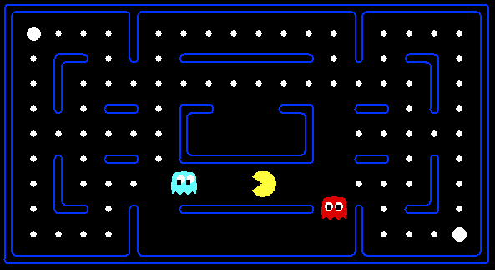



Q(s1,a)
Q(s2,a)
Q(s3,a)
Notes:
With tabular Q-Learning, learning from situation 1 does not help in figuring out good action in situation 2, even though they are very similar
Things are even more drastic with situation 3, where the only difference w.r.t. situation 1 is a far away missing dot (which most likely does not affect policy)

Slide 28
feature-based representation
Describe state-space using a vector of features (properties)
Feature is a real function on state-action space (often 0/1-valued)
Capture important aspects of state/action
Examples
Distance to closest ghost
Distance to closest dot
action moves closer to food?
1/(distance to ghost)²
is pacman in a tunnel?

Slide 29
Linear Q-Value Function
Assume Q-Value function is a linear combination of features
Pros:
Learning from one state is shared to similar states in feature-space — speeds up learning
Can cope with continuous states
Cons:
Learning from one state is shared to similar states in feature-space (even if their q-value is very different)

Slide 30
Approximate q-learning
Update in exact learning can be interpreted as adjusting q-value by difference between expected and predicted values
Approximate Q-Learning updates weights similarly
adjust weights by their marginal effect in overall update
Difference
Notes:
Q^{(i+1)} = Q^{(i)} + \alpha[R(s,a,s') + \gamma V^{(i)}(s') - Q^{(i)}(s,a)]
w_k^{(i+1)} = w_k^{(i)} + \alpha[R(s,a,s') + \gamma V(s') - Q^{(i)}(s,a)]f_k(s,a)

Slide 31
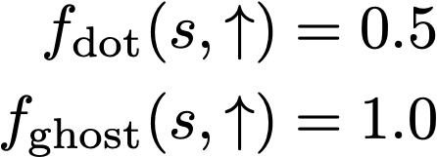
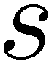
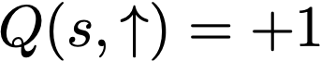
example: pacman

Slide 32
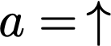
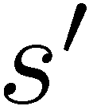
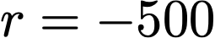
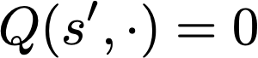
example: pacman

Slide 33
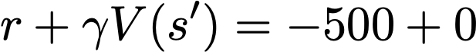
example: pacman

Slide 34
example: pacman

Slide 35
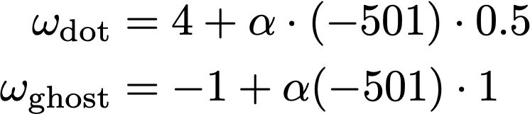
example: pacman

Slide 36
example: pacman
se ⍺=2/501
Notes:
alpha = -2/501

Slide 37
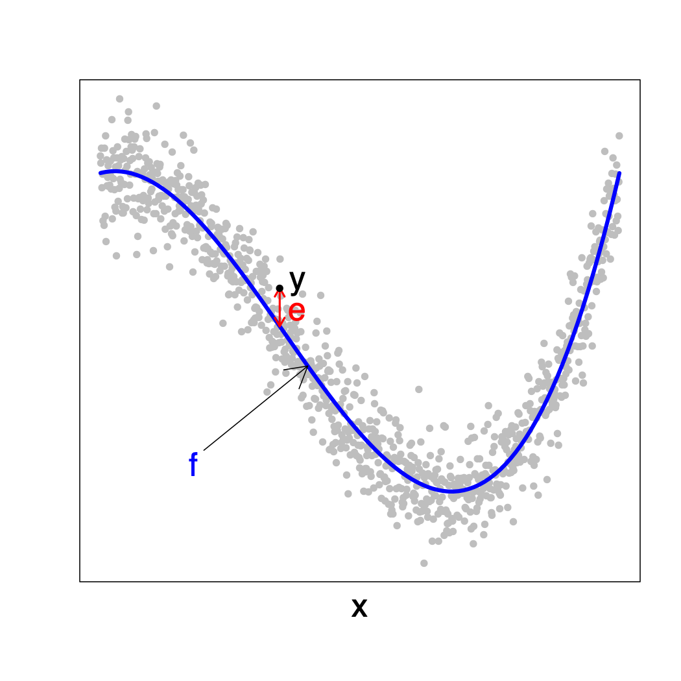
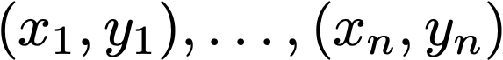
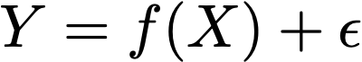
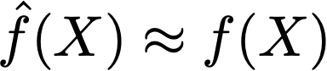
Regression
Known:
Assumed:
Objective:

Slide 38
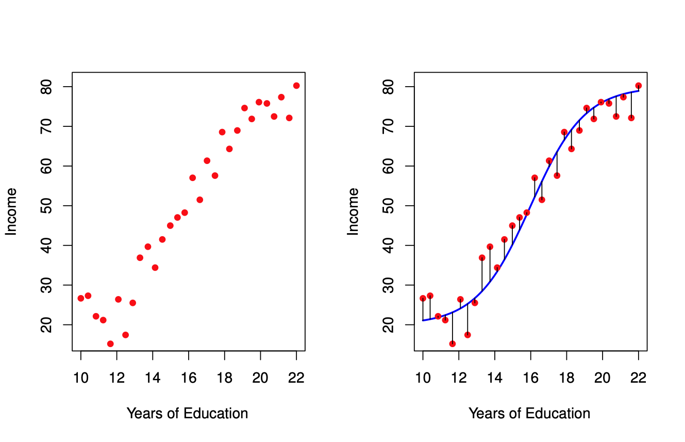
regression
Predict income as function of years of education
Estimated function generalizes to unseen data

Slide 39
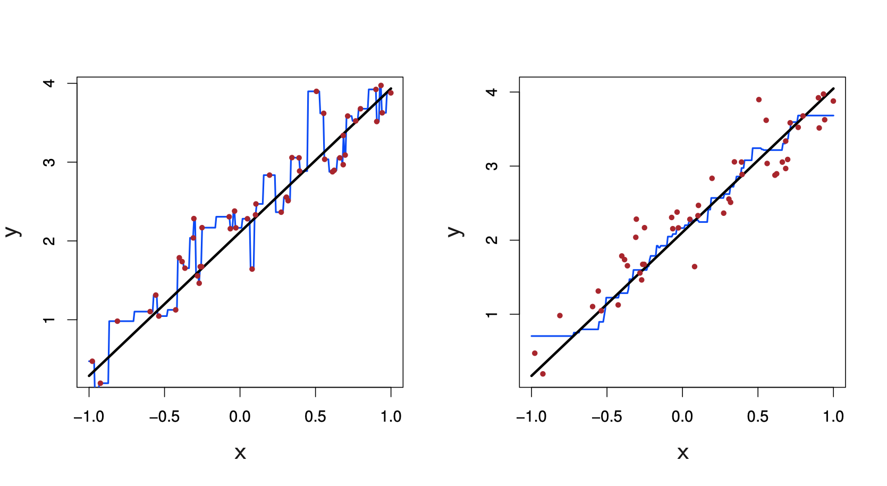
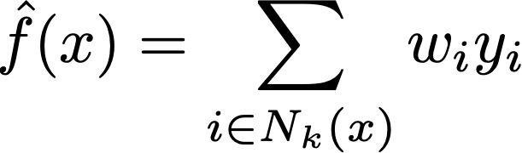
non-parametric regression: nearest neighbor
k=1
k=9

Slide 40
nearest neighbors
Caveats
Require lots of data (bad for starting learning)
Computing function is expensive (needs to find closest neighbors)
Outliers can have great effect
Advantages
Can approximate very complicated functions

Slide 41
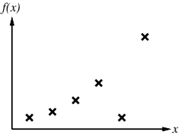
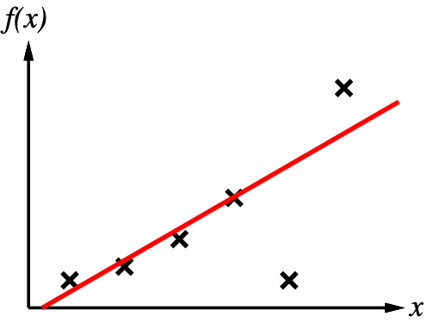
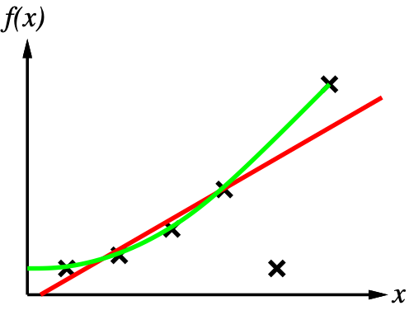
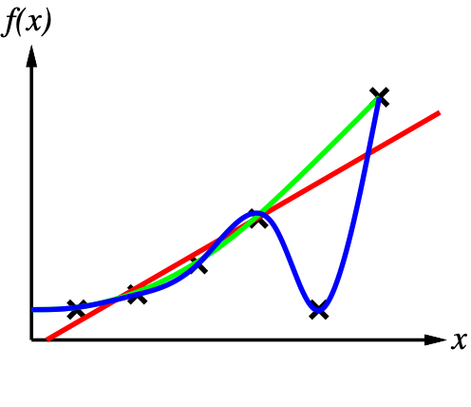
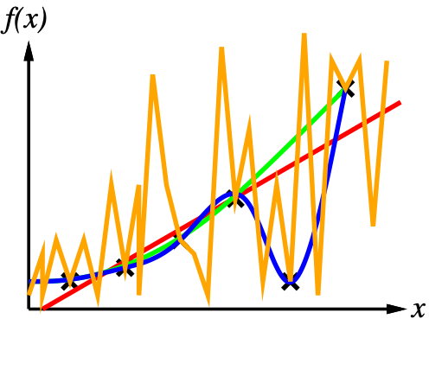
fitting, underfitting, overfitting
goal is to perform well on unseen data

Slide 42
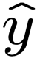
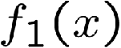
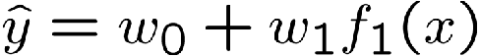
parametric regression: linear regression
Assume function is a linear combination on features (inputs)
40
26
20
24
22
20
30
40
0
0
20
20
30
10
20
0
10
0
Prediction:
Prediction:

Slide 43
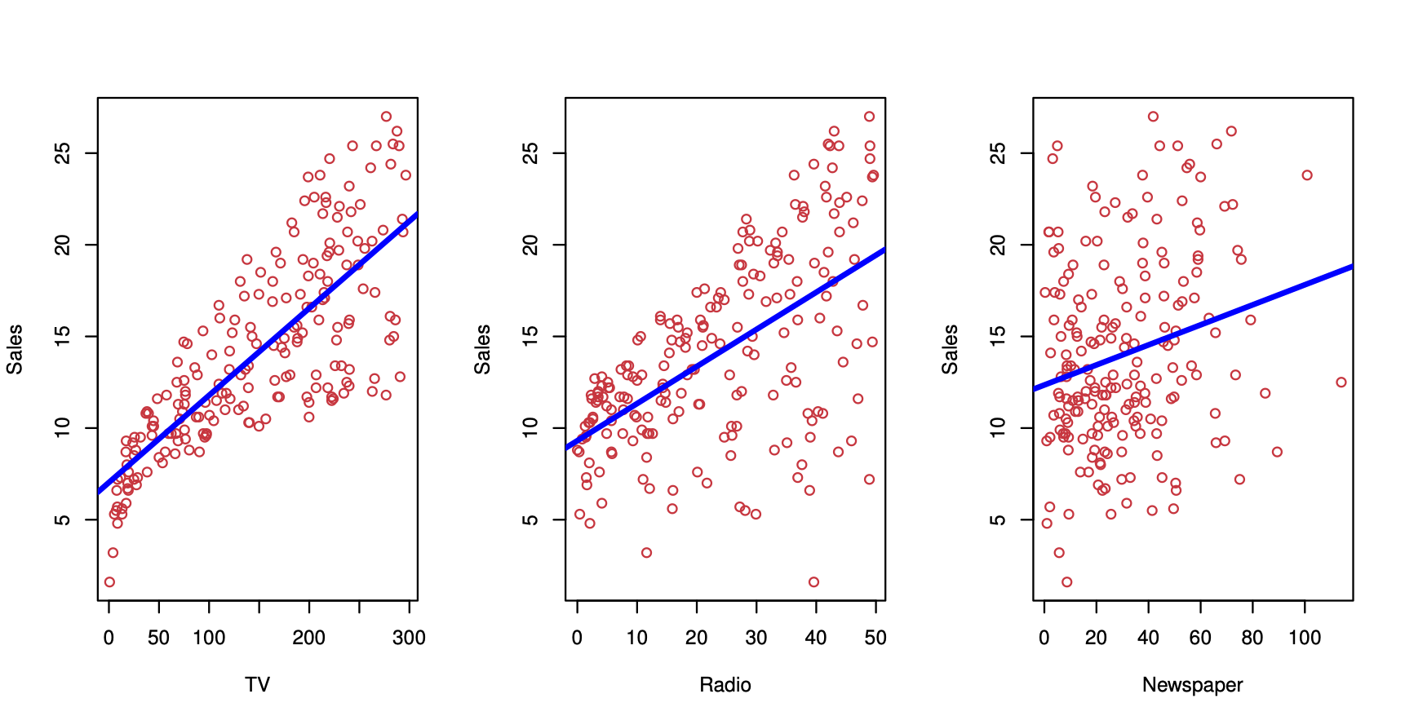
Linear regression

Slide 44

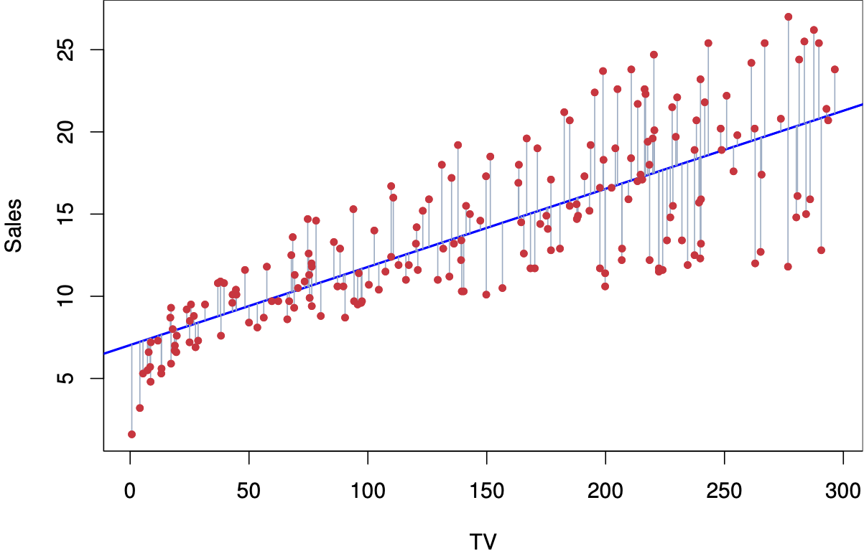
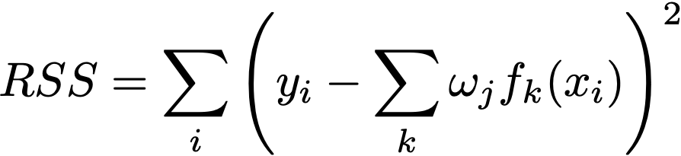
least squares
Error or residual εi = yi - y(xi):
Squared Loss:

Slide 45
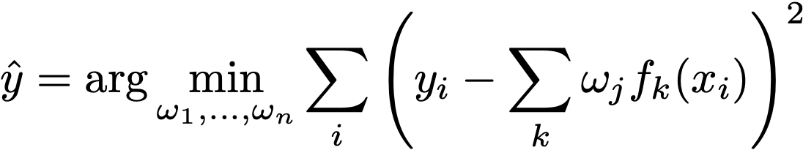
least squares
Find
Squared loss is convex function — there is unique minimizer
closed-form solution
iterative optimization methods
e.g., gradient descent

Slide 46
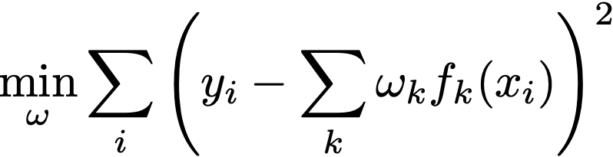

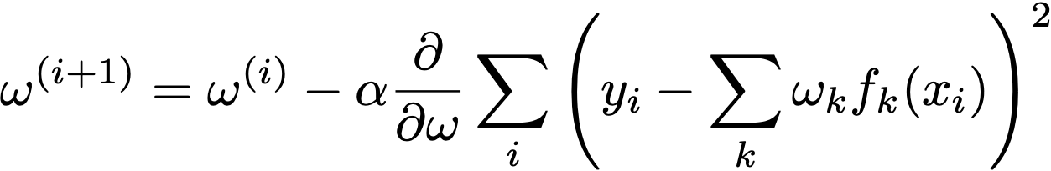

gradient descent
Iterative optimization method to solve
Optimal for convex function, finds local optimum in general
Start with arbitrary guess for ω
Repeat until convergence
target
prediction
learning rate

Slide 47
gradient descent
ω0

Slide 48
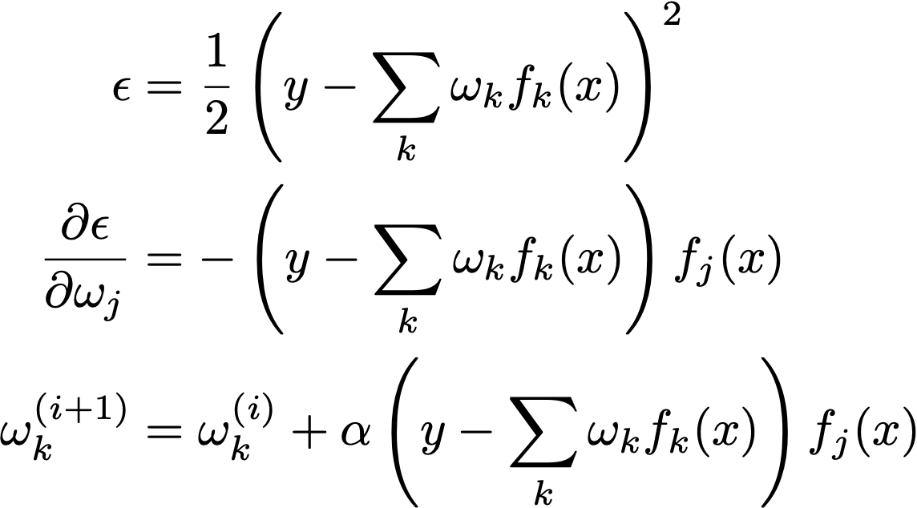

online gradient descent
Update regressor with every new data point y,x
target
prediction
learning rate

Slide 49



back to approximate q-learning
Approximate Q-learning can be seen as an online regression problem where the target is the sample Bellman update and the predicted value is the current estimate
target
prediction
learning rate
Notes:
w_k^{(i+1)} = w_k^{(i)} + \alpha[R(s,a,s') + \gamma V(s') - Q^{(i)}(s,a)]f_k(s,a)

Slide 50
approximate q-learning
Why assume linear combination
Avoids overfitting
Mathematically convenient
Very expressive
non-linear functions can often be represented by adding new features
e.g., y = 3x + 4x² = 3x + 4z, z = x²

Slide 51
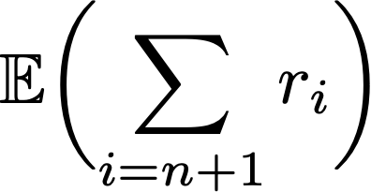
learning paradigms
Supervised learning
Unsupervised learning
Reinforcement learning
Given:
Learn:
so as to maximize

Slide 52
bibliography
Chapter 21 of AIMA Book
Notas de Aula da Prof. Anna Reali (EP-USP)
Notas de Aula da Prof. Leliane (IME-USP)
Notas de Aula do Prof. Edirlei de Lima (PUC-RJ)
Lecture notes at ai.berkeley.edu
Sutton & Barto. Reinforcement Learning, 2nd ed.

